Slide 1
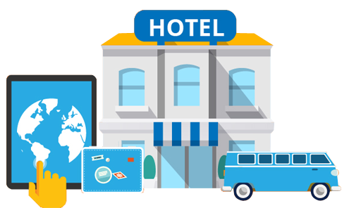


OPIM 5604 – Predictive Modelling – Final Project
Team 2 – Afternoon Batch
Mohammad Yasar Arshad
Rikdev Bhattacharya
Yunong Liu
Suriyaa Sugumar Valantina
Wenyi Xu

Slide 2
OPIM 5604 Predictive Modelling: Team 2
Expedia wants to predict the booking outcome in a user session to devise customized marketing strategies and thereby improve the existing conversion rate
CURRENT SCENARIO
GAP ANALYSIS
Need to identify and understand the various drivers influencing the customers to make a booking in a specific user session
Need to enable data driven marketing strategies to improve the existing conversion rate
DESIRED GOAL
High user traffic on multiple point of sale portals all over the world
Current Conversion Rate of ~10% on hotel bookings
Captured user session information related to geographies, interests and their search patterns
Expedia wants to identify users who are not likely to book in a particular user session well in advance and devise promotional efforts to influence them
A framework in place to identify the factors that influence user behaviour to make a booking in a specific user session
Direct customized promotional and marketing efforts towards users that are not likely to book and who are likely to book; so as to increase the existing conversion rate
Improve the existing conversion rate
CHALLENGES
Computational capabilities
Too many nominal non-explanatory variables
Missing Information :
- User Web Activities
- Demographic Details
Data inconsistencies
Ambiguously defined data
Business costs not clearly defined

Slide 3
OPIM 5604 Predictive Modelling: Team 2
Structured approach to identify customers who are less likely make a hotel booking in a user session
Evaluate the current business performance
Develop statement of objective
Identify factors that influence the booking behavior
KEY FINDINGS
~ 78% of the overall traffic is generated from POSA continent 3 where 64% of the searches are to destination continent 2
~ 88% of the customers prefer hotel/package booking for at most 3 days
~ 85% of the customers make a booking just before 2 months of travel
~74% of the customers book couple or solo trip packages without children
Check-in rate in the second half of the year is more than the average yearly check-in rate
First half of the year experiences significantly lower traffic volume but has a higher conversion rate
Problem Formulation
Acquire data
Sample data based on the frequency of booking events in the clusters
Sampling
Univariate and Multivariate Analysis
Identify data redundancy, abnormalities, inconsistencies and potential outliers
Pattern Discovery and understanding relationships
Exploration
Variable creation and removing inconsistencies
Missing Value and Outlier treatment
Standardization
Dimensionality reduction
BUSINESS RECOMMENDATIONS
Modification
Design customized time bound discount deals to entice customers to make a booking in the current user sessions.
Provide value add packages and incentivize customers on their next booking by making them join the Expedia loyalty program.
Design customized packages for customers in the priority sector.
Run advertisement/promotional campaigns in H1
Design hotel packages with complimentary deals that cater to 88% of the customers who prefer booking for at most 3 days
Design customised packages for couples and solo trips which account for 74% of the booking
Model Creation and Comparison
Define Selection Criterion: High Specificity and Low FNR
Best Model: Ensemble Decision Tree
Modelling and Assess
Evaluate and interpret analysis results into tangible decisions
Identify next steps for client stakeholders to enable consumption / implementation
Develop documentation and training material as needed
Analysis

